Slide 1
Project II : Inventory System
Josep Atencia - UPC

Slide 2
Grid – based Inventory
2 main elements:
Vector of Slots
Vector due to it’s fats iteration
List of inventory items
List because the items can get in and out the inventory
Slot
Cell of the inventory, where the items are placed
GuiSlot.h/.cpp
Inventory item
Representation of a world item at the inventory
GuiItem.h/.cpp
Both are GuiElements

Slide 3
Slots
Attributes
iPoint coord
Coordinate at the inventory
GuiItem* inventory_item
The item that is placed over the slot (if there’s any)
SDL_Rect rect
The rect that represents the slot at the screen

Slide 4
Inventory item
Attributes
Int Size
Number of cells that form the item
iPoint[Size] coords
Coords that represent the shape of the item
Slot* reference_slot
Slot of reference at the inventory (upper_left of the item)
Inventory* inventory
Inventory where the item belong to
Image image
Image that represents the item at the gui

Slide 5
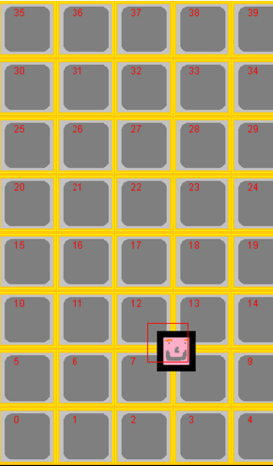
Main Features
Storing items
Placing items visually within slots
Dragging and placing items with the mouse
Some feedback!

Slide 6
Before beginnig…
Wath GuiInventory.h to see what methods are there and what they do (there’s an explanation)
Some will be very useful to use at the TODOs
Some, as AddItem(), AutomaticAddItem(), CheckDraggedItem(),… gather the basic functions of the inventory to use them.
While doing the TODOs look, where is the function being filled used to better understand it’s purpose
Ask me if you have any doubts! ☺

Slide 7
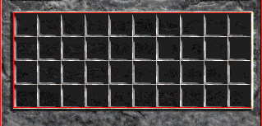
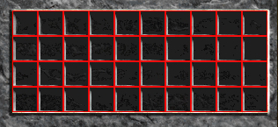
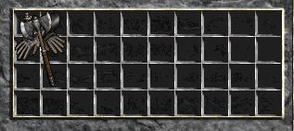
TODO 1
Create the inventory
Fill slots vector at inventory constructor
Calculate coord and rect
When done, press F1 to enter debug mode
A grid wil be painted
Pressing 1, 2, 3,4 will add different items (at 0, 0)

Slide 8
TODO 2
Assigning items with slots
The item should be assigned to each slot that is placed over
Fill AssignItemToSlots()
Recieves the item and the coord where it will be placed
Use the item coords to know wich slots is placed over
To know a slot for its coords use GetSlotFromCoord()

Slide 9
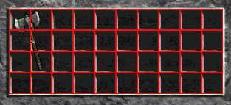
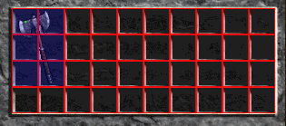
TODO 2: Result
Enter debug mode
If done well, the ocupied slots will be drawed as blue

Slide 10
TODO 3
Placing an item
The items can only be placed at free slots, if there’s another item, they can’t
Have to know if placing an item on a certain coord (upper-left slot) is possible
Fill function IsPlaceable()
As with TODO 2, check the slots if the item was placed on a certain coords
If there’s an assigned item to a slot, return false
If every slot checked is free, return true

Slide 11
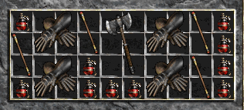
TODO 3: Result
As result, the items would be placed correctly now
Where is used:
AutomaticAddItem()
CheckDragItem()
Thanks to CoordExist() the items can’t be placed outside the grid.

Slide 12
TODO 4
Dragging an item
Gui has the dragged_item, because it is drawn over everything.
If clicking on an item it becomes the dragged_item (see GuiItem::Update())
If it’s the dragged item, then it moves
Fill function Move() at GuiItem
Use mouse position not mouse motion
Center the item around the cursor, not on the edge

Slide 13
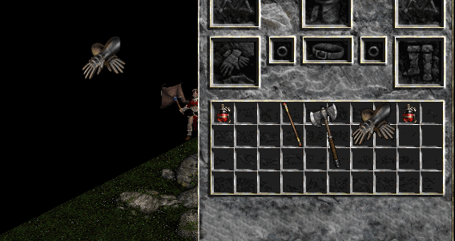
TODO 4: Result
As result, when an item is picked it can be dragged freely.
If an item is dragged to the scene it is deleted
(on game the world item should be thrown)
Still cannot be placed at the inventory

Slide 14
TODO 5
Placing dragged item
To place the dragged item we need to know over wich slots is hovering the item
To detect that, we use a pivot
Placed at the upper-left cell
When the item is over the inventory, it’s checking over wich slot the pivot is over
Uses the coordinates system conversion functions
Fill function GetCoordFromItem()
Return the slot coord where the item is hovering, so the function IsPlaceable() can check if it can or not be placed there
Use GetPivotPosition from GuiItem
Use ScreenToSlot(), wich convert form screen point to a slot coordinate

Slide 15
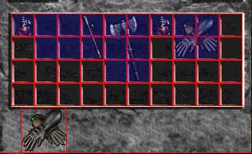
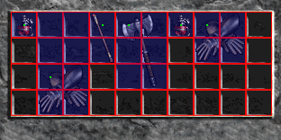
TODO 5: Result
Now the items can be picked and placed to another free space in the inventory
Or maybe not…
The item won’t be placed where an item has been before.
The slots remain assigned to an item, so they are ocupied even if there’s no item over them

Slide 16
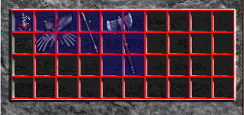
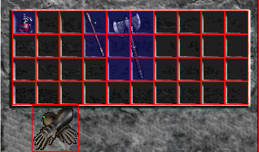
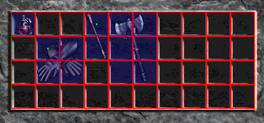
TODO 6
Freeing Slots
As seen at TODO 5, the slots should be freed when it’s item is picked.
Fill FreeSlots() at GuiItem
Like AssignItemToSlots() but doing the oposite.
Set the those slots inventory item to NULL
As result, the items will be able to be placed on any free space where they fit.

Slide 17
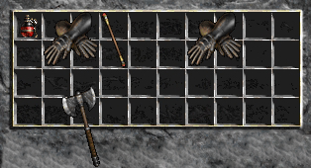
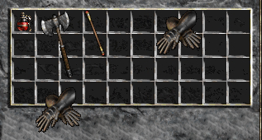
TODO 7
Exchanging items
If there’s only one item that disable the dragged item to be placed , these items should be able to be exchanged
The last dragged item is placed
The item that was placed becomes the dragged item

Slide 18
TODO 7
Fill IsPlaceable() (the sequel)
Variation of normal IsPlaceable()
Check if there’s an item where is going to be placed
If it’s found that there’s more than one, return false, it can’t be placed
If at the end there’s only one item return true
If there’s no items return true
Use extra_item double pointer to check if there one or more items, and by the way, get wich item has to be exchanged.

Slide 19
TODO 8
The player needs feedback
The player should be notified if an item can be placed, or exchanged.
The slots color will change according to the situation
GREEN: if item can be picked or if can be placed at these slots
YELLOW: if an exchange is possible, the exchanging item slots are drawed yellow
RED: if the item can be placed on a certain slots

Slide 20
TODO 8
Fill SetSlotsState()
Recieves the item and the state to set the slot
Iterates the slots under the given item and sets their states to the given one.
Explore the code and see where and how to put this function in order to satisfy the mentioned effects.

Slide 21
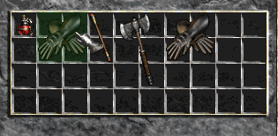
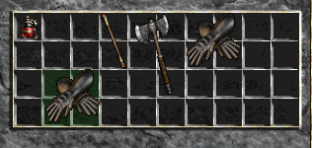
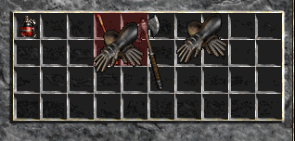
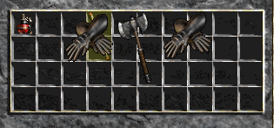
TODO 8

Slide 22
Homework
Adapt the code so it relates world items with inventory items
Create the quick acces inventory at the HUD
Should only accept consumable items
Have a numbered shortcut (1,2,3,4)
Try making a health potion to work

Slide 23
Other methods
Having an array of the occupied slots at GuiItem
Would optimize the search of this slots when needed (at FreeSlots() for example.
But, should do another new and delete for this array
Major risking of leaking memory
Slots not to be a gui element
There’s no need for it to be one, it can just be a struct used only by inventory

Slide 24
Bibliografy
Best way: asking or searching at: gamedev.stackexchange.com
http://gamedev.stackexchange.com/questions/51588/inventory-grid-detection
http://cboard.cprogramming.com/game-programming/149561-how-implement-inventory-system-2d-game.html
http://gamedev.stackexchange.com/questions/72237/how-to-manage-grid-based-inventory-with-items-larger-than-1x1-cell

Slide 25
Thanks for you attention!
Josep Atencia - UPC

